Slide 1
What Does L E A D E R S H I P Mean to Graduate Students?

Slide 2
L E A D E R S H I P
L - Listening: Effective leaders value the input of their team and make a point to actively listen.

Slide 3
L E A D E R S H I P
E - Empathy: It allows leaders to understand and connect with their team on a deeper level.

Slide 4
L E A D E R S H I P
A - Ambition: Aspiring to achieve great things and motivating others to do the same

Slide 5
L E A D E R S H I P
D - Decisiveness: Making decisions promptly and efficiently to move projects forward.

Slide 6
L E A D E R S H I P
E - Empowerment: Leaders empower others, giving them the confidence and resources to excel.

Slide 7
L E A D E R S H I P
R - Relationship-building: Investing time in building and nurturing positive relationships with team members

Slide 8
L E A D E R S H I P
S - Self-awareness: Recognizing strengths and working on weaknesses is vital for leadership growth.

Slide 9
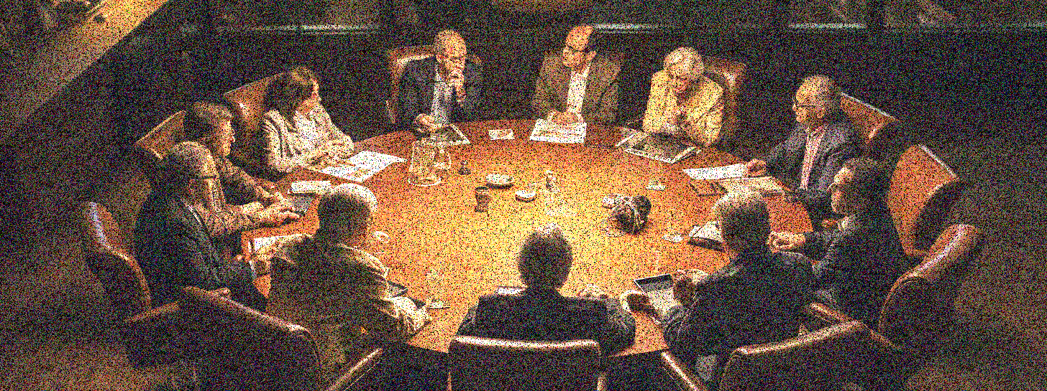
L E A D E R S H I P
H - Humility: Acknowledging that they don't have all the answers and valuing the expertise of others

Slide 10
L E A D E R S H I P
I - Innovation: Embracing new ideas and driving change to achieve better outcomes

Slide 11
L E A D E R S H I P
P - Patience/Persistence: Waiting for the right opportunities and allowing team members the time they need to grow and learn

Slide 12
We Should Avoid Flawed M A N A G E M E N T in Leadership Training

Slide 13
M A N A G E M E N T
Misdirection - When leaders fail to provide clear guidance or shift goals without proper communication

Slide 14
M A N A G E M E N T
Arrogance - Overconfidence and a refusal to admit mistakes or seek feedback.

Slide 15
M A N A G E M E N T
Neglect - Ignoring team needs or overlooking the well-being of team members.

Slide 16
M A N A G E M E N T
Apathy - Lack of passion or interest in the work or in the growth of the team members

Slide 17
M A N A G E M E N T
Greed - Prioritizing self-interest over the good of the team or organization

Slide 18
M A N A G E M E N T
Exclusivity - Favoritism or not giving equal opportunities to all team members.

Slide 19
M A N A G E M E N T
Micro-management - Over-controlling team members and not trusting them to perform their tasks independently

Slide 20
M A N A G E M E N T
Evasion - Avoiding responsibility or not addressing critical issues directly

Slide 21
M A N A G E M E N T
Narrow-mindedness - Not being open to new ideas or diverse perspectives

Slide 22
M A N A G E M E N T
Turbulence - Creating unnecessary drama or frequently changing decisions, leading to instability

